Slide 1








Hormone Health for Pets
Your dog deserves to live longer
NZ$ 2m bridge round capital raise
Copyright © 2026 - InsituGen. All Rights Reserved.

Slide 2

NZ$ 2m bridge - In summary
Traction as of today
What this bridge unlocks (next 12 months)
Why this de-risks Series B
  First product NeuterReadyTM launched in NZ & UK
  Paying customers (labs / vets)
  19 patents granted across key jurisdictions
  Revenue ramp in NZ & UK
  Australia & Germany launch
  SpayReady & SpayCheck launch
  Point-of-Care simplification milestone
  Strategic partnerships signed
  Multi-market validation
  Expanded portfolio
  Clear Point-of-Care pathway
  Strategic partnerships in place

Slide 3


SEX HORMONES MATTER
Premature neutering can lead to a lifetime of health issues.
Over 100 million dogs* are neutered / spayed without being assessed for maturity
Brain, Blood, & Heart
Thyroid & Immune System
Kidney & Urinary
Muscle, Weight, & Joints
*US, Germany, UK, France, Italy, Spain, Australia only (source: AVMA / PDSA / ZZF / veterinary-practice.com / dogster.com).

Slide 4


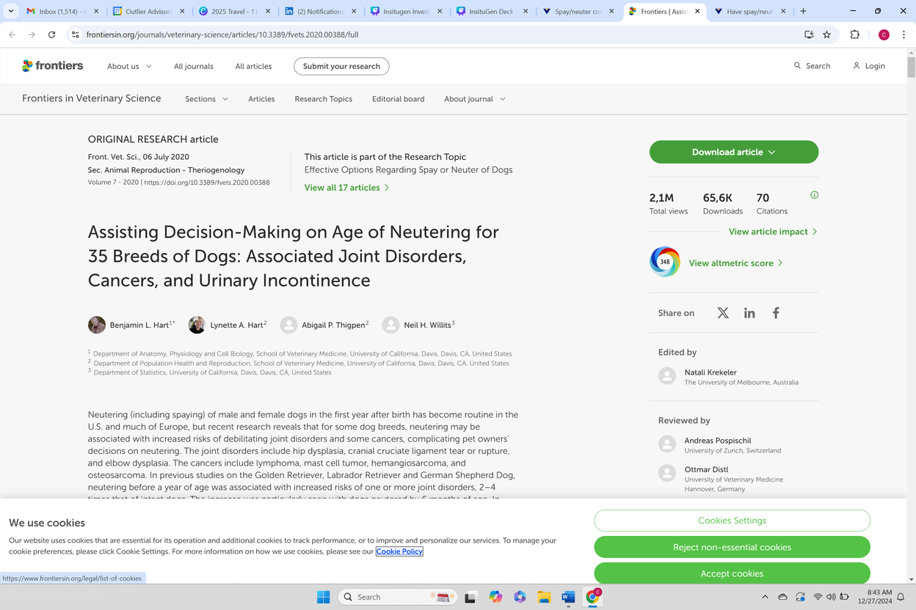

”When to Neuter” has become a hot topic
This decision is made millions of times per year without objective data.
  Frontiers shows this article has 2.2M views
  Altmetric (impact) score of 343
  Top 5% of all published scientific articles
UC Davis Research published in 2020
23 media outlets, including popular media like the NYT, the Washington Post, Readers Digest, & VIN have published articles on the topic.
...but Veterinarians lack tools
Current tools are either unavailable, impractical, or too expensive to be routine.
Veterinary clinics do not offer any maturity assessments today!
https://www.frontiersin.org/research-topics/8524/effective-options-regarding-spay-or-neuter-of-dogs/magazine

Slide 5
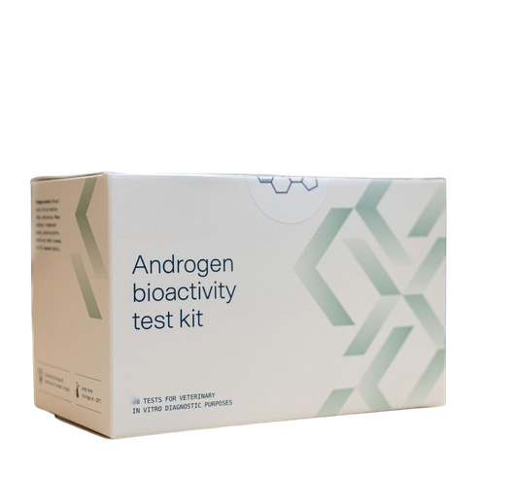


InsituGen’s multi-patented NeuterReadyTM test
Changes Everything
POWER to own your dog’s health
CLARITY on when it is the right time
CONFIDENCE in your choice

Slide 6
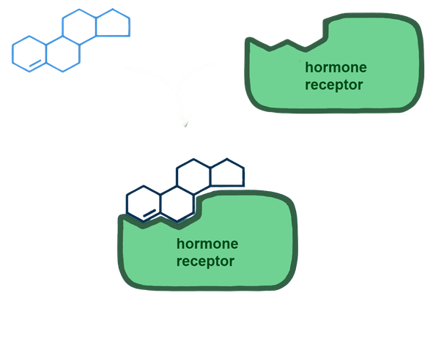
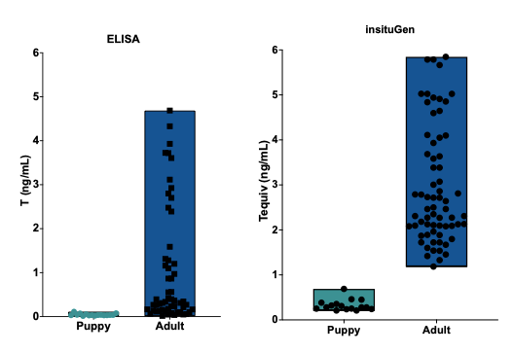
We measure hormones based on function not structure!
Standard hormone tests, only measure steroid hormones based on their specific structure.
InsituGen’s tests measure steroid hormones based on their function.
ACCURATE
The NeuterReadyTM bioassay clearly differentiates between puppies and adults defining sexual maturity.
SIMPLE
Completed in less than one hour using standard laboratory equipment at an approachable price point.
ACCESSIBLE
Developing an agnostic platform allowing a scalable solution that works anywhere and everywhere.
ELISA
NeuterReady
Overlapping ranges
Significant gap between ranges
More sensitive at low concentrations
19 patents granted/allowed
4 Patent Families across 11 to 12 Jurisdictions
27 Patent Applications in Progress

Slide 7
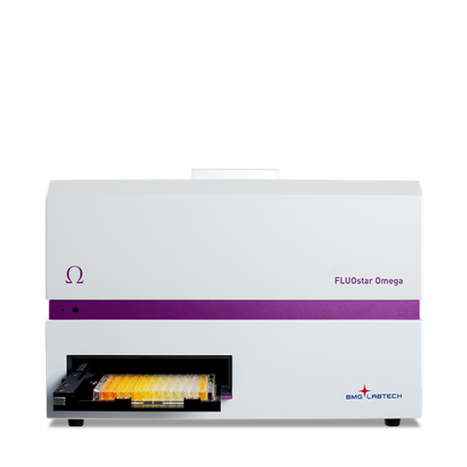
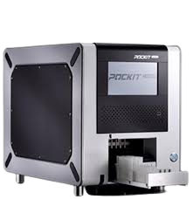
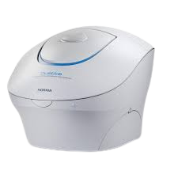
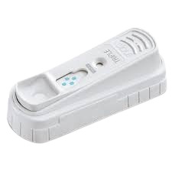
TECHNOLOGY APPLICATIONS
Agnostic & scalable solutions that work everywhere
Reference Lab
PoC Platform
PoC Lateral Flow Test
(available)
(development)
(development)
Bench Instrument or Cartridge based. It will allow decentralized testing. Fluorescence output but adaptable to other e.g. colorimetric.
Validated and Operational in high volume Commercial Workflows.
High sensitivity quantification of androgenic and estrogenic activity in complex samples at sub ng/mL levels.
First-in-class functional lateral flow for hormonal activity. Interpretable results within 15 minutes. Modular with semi-quantitative fluorescence output or qualitative with colorimetric output.

Slide 8
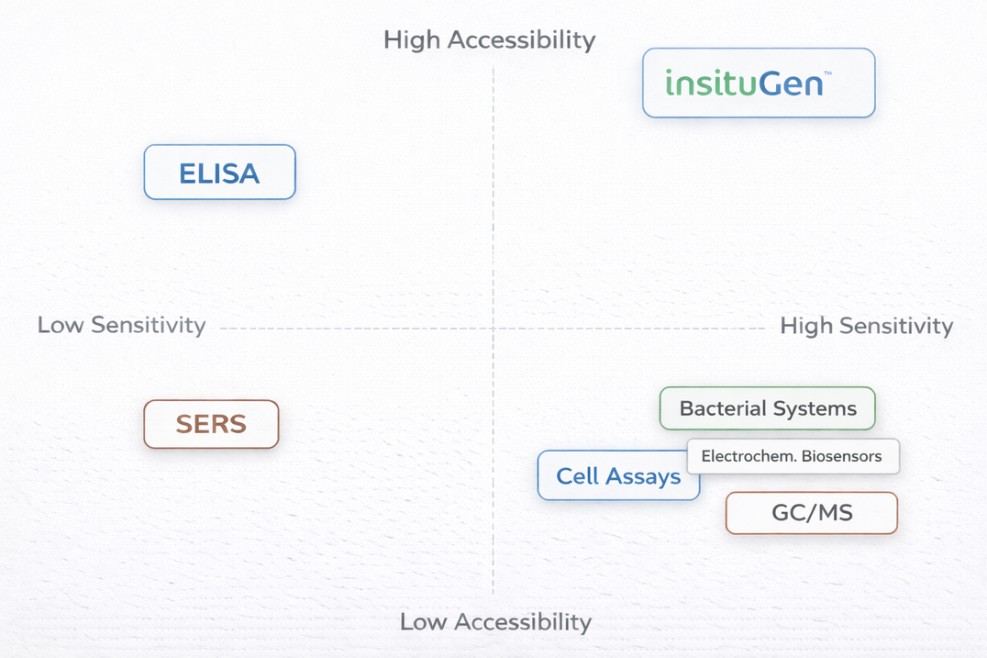
insituGen is more sensitive than ELISA and more accessible than GC-MS: NO DIRECT COMPETITION
Commercial immunoassays lack sensitivity, while mass spectrometry, though more accurate, requires specialized equipment and is expensive and not readily available. Both methods can’t detect unknown steroids and can’t measure functional activity of steroids. InsituGen’s technology detects unknown steroids (including phytosteroids and steroid mimical chemicals) and captures their functional effects. This gives a clear picture of whether physiologically relevant hormone-like activity is present

Slide 9
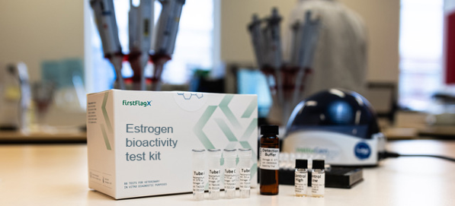
Hormone Health
Revolutionizing pet health monitoring with a comprehensive hormonal health suite of lifestage diagnostics.
2025
2026
2026
2027
NeuterReadyTM
SpayReady
SpayCheck
Longevity
Annual
NeuterReady™
Canine
SpayReady
Canine
Ovarian Remnant Syndrome
Canine
LongevityAnnual
Canine
Hormone
Health
Hormone
Health
Hormone
Health
Hormone
Health
Hormone Health
Hormone Health
Hormone Health
Hormone Health
Male Puppies and Young Dogs
Prior to Neuter
Female Puppies and Young Dogs
Prior to Spay
Female Dogs post-Spaying. Detecting ovarian remnant tissue
Routine annual health test for all Dogs

Slide 10

Strong secular tailwinds in animal health
Animal Healthcare market is forecast to grow at a CAGR of 9.4% from 2025 to 2034*
Expanding and aging pet population**
Pets living 10%+ longer and care expectations are expanding**
Demographic shift benefiting strengthening pet-parent bond**
*https://www.precedenceresearch.com/animal-healthcare-market
** IDEXX Laboratories Inc.

Slide 11
Global Market Opportunity for Hormone Health
US$ 2B Market Size
US$ 1.72B*
SpayReady Canine
LongevityAnnual
Initial SAM in launch geographies: US$ 117m
US$ 250M**
*Adjusted by current share of routine / preventive visits across dog population. US figures extrapolated to RoW based on IDEXX Data
** Adjusted by neuter / spay rate across puppies. US figures extrapolated to RoW based on pet population data
NeuterReady &
SpayReady/SpayCheck

Slide 12

Our
Strategy
Create Platform Agnostic Bioassay starting with
NeuterReadyTM
Fitting into any Vet workflow and possible DTC use cases developing the IP into a platform-agnostic solution, it allows InsituGen to monetize both Central & POC channels
Go-to-Market
Partner with diagnostic company to develop the Point-of-Care technology
This allows InsituGen to continue developing IP for other verticals and to expand our test menu (e.g. lateral flow assay application for rapid and simple processing at PoC)
Partner with Global KOL’s and Vet Associations to change the way that Steroid Hormones are tested
We have established relationships with KOL‘s like Dr Marty Greer (US) & Prof. Sandra Göricke-Pesch (Europe).
Secure distribution deals with TOP Central labs and Vet Groups in select geographies
This allows the assays to be scaled quickly and efficiently without having to understand and navigate geographic market complexities. Delivered in NZ (Q3/25) and UK (Q4/25)
Run marketing campaigns targeting at PetParents, Breeders and Vets
Preparing the Market for market entry will be critical as this is a new concept. Executed in NZ

Slide 13
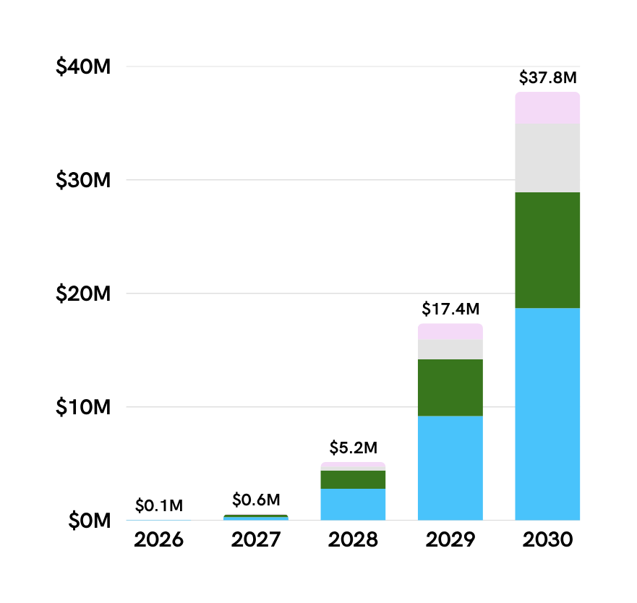

Sales Plan for Hormone Health
Healthy growth in launch countries
Early NZ data is tracking in line
6%-8% penetration rate
HORMONE HEALTH SUITE OF LIFESTAGE DIAGNOSTICS
6% penetration rate
NeuterReadyTM*
24% penetration rate
SpayReady**
LongevityAnnual***
SpayCheck****
Point-of-Care available in 2028
36% penetration rate*****
all figures US$
*NeuterReady: 2025 launch NZ & UK / 2026 AUS & Germany market entrance / 2028 US market entrance
** SpayReady: 2026 NZ & AUS & UK & Germany market entrance / 2028 US market entrance
*** LongevityAnnual: 2027 US market entrance
****SpayCheck: 2027 NZ & AUS & UK & Germany market entrance / 2028 US market entrance
***** UK / NZ / AUS / GE penetration rate: 72%

Slide 14
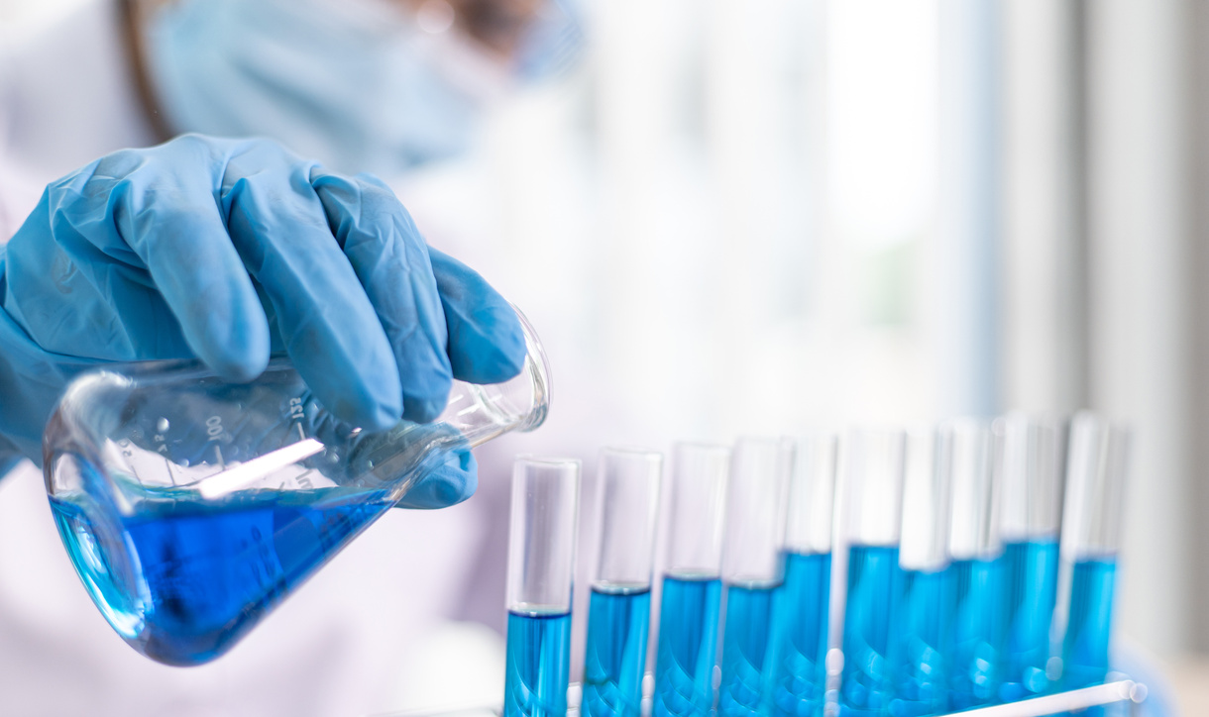
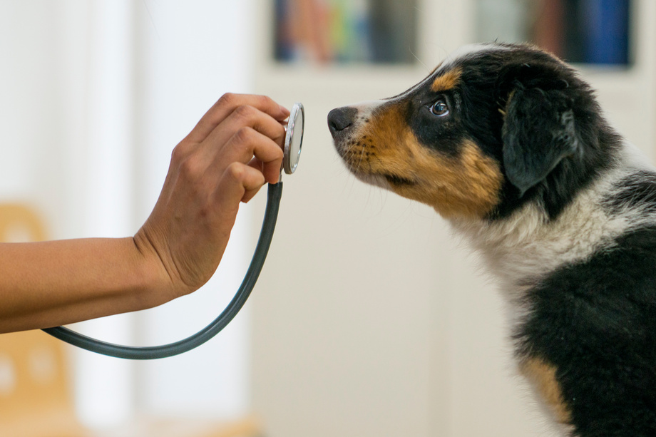
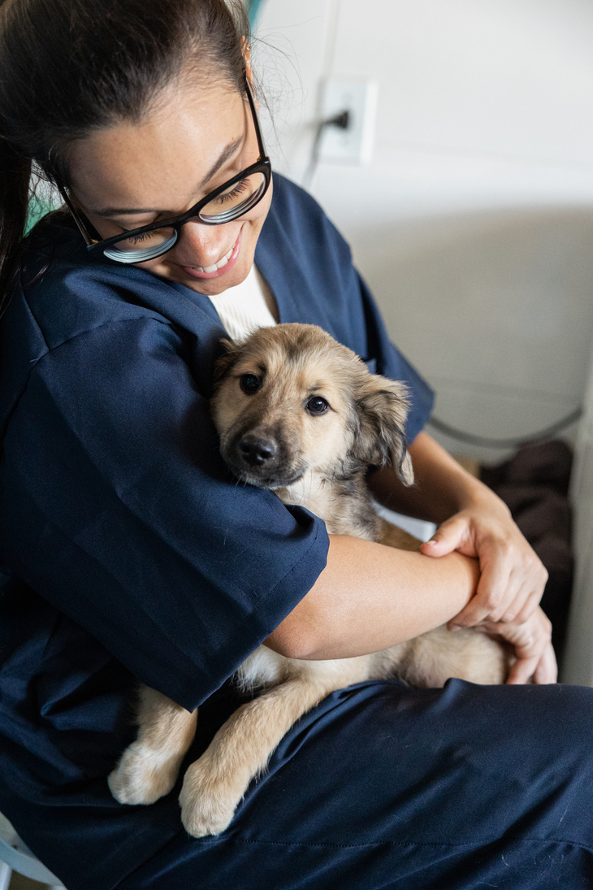
We “win” when is routine and reasonably priced
NeuterReady™
For ALL
Healthy Margins
US$ 17
US$ 35
US$ 55
Wholesale
Price
Suggested Vet List Price
Suggested Client Price

Slide 15
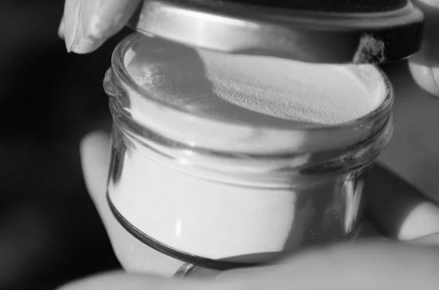



InsituGen’s strong platform for growth beyond animal health
Multiple monetization opportunities with already recurring revenue generating three verticals and one vertical under study
Consumer Goods Testing
Water / Environment Testing
Anti-Doping
Human Health
  Existing vertical
  Detection of known or unknown estrogen and androgen activities in human supplements and hygiene products
  InsituGen testing laboratory in New Zealand
  Recurring revenue with manufacturers of sports supplements, health supplements, and feminine hygiene products.
  Can be adapted to kit form, for use in existing service laboratories (e.g. Eurofins, ALS, SGS).
  Existing vertical
  Detection of known or unknown estrogen and androgen activities in freshwater and drinking water
  InsituGen testing laboratory in New Zealand
  Ongoing testing for an environmental law organisation from waterways throughout New Zealand
  Can be adapted to kit form, for use in existing service laboratories (e.g. Eurofins, ALS, SGS).
  Existing vertical
  Detection of unknown androgen activities in the plasma of competing animals
  Exclusive distribution contract with Berlinger Special AG. Berlinger is the global market leader for anti-doping products
  Recurring revenue with leading racing laboratories
  Sales potential of US$ 1M (animal only)
  Can be enlarged to human anti-doping. Proven case with Marion Jones. 300k plus anti-doping tests per year (WADA)
  New vertical
  Studies with research institutes under way. Potential applications are:
  Functional Hormone Panel
  Cancer Monitoring Tool
  Cardiometabolic / Neurodegenerative Biomarker
  Adrenal Stress Monitoring / Cushings or Addisons Test Biomarker

Slide 16
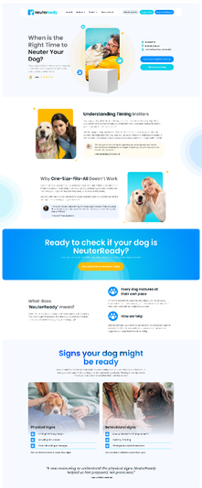
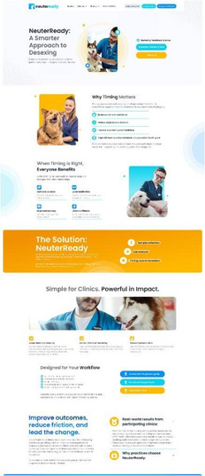


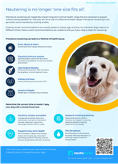
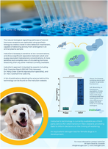
From its foundation in 2020 to the launch of the first animal health product in 2025
Always delivered key milestones
Bridge Round III
now
2025
NZ & UK market launch
Founded Q3 2020
Seed Round closed Q2 2021
Series A Round
closed Q4 2022
Bridge Round I
closed Q3 2024
Bridge Round II
closed Q4 2025
SEED NZ$ 2M
Series A NZ$ 3.8M
Bridge NZ$ 1.7M
Bridge NZ$ 0.7m
Bridge NZ$ 2.0m
Key Milestones
Deliverables
  Establish operations
  Commercialize anti-doping - initial inventor target
  Develop IP portfolio
  Explore pipeline opportunities
  Partnership with Berlinger on anti-doping
  Develop pipeline & lead application identification (companion animals)
  Establish in-house manufacturing
  Define lead product NeuterReadyTM/ SpayReady
  Complete go to market strategy
  Complete proof of concept clinical study
  Define next pipeline companion animal products
  Demonstrated utility of platform in other applications
  Gained first paying customers
  Launched NeuterReadyTM in NZ & UK with a B2C and B2B marketing campaign
  Established strategic partnerships
  Simplification NeuterReadyTM
  Expanded applications in other verticals
for more information, visit:
www.neuterready.vet
www.neuterready.com
Our lead investor is Pacific Channel Limited, a leading technology VC from New Zealand. Visit www.companiesoffice.govt.nz for updated shareholder structure. InsituGen’s company # is 7904916

Slide 17
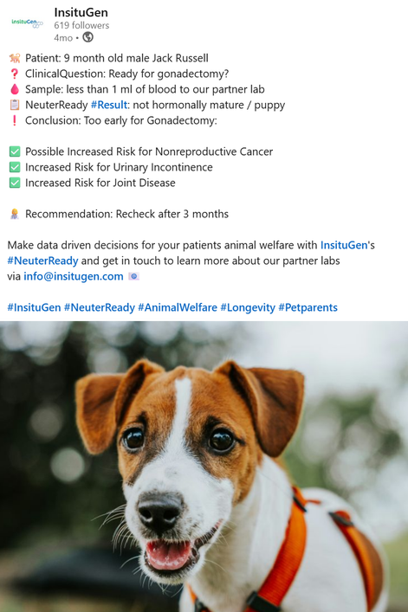


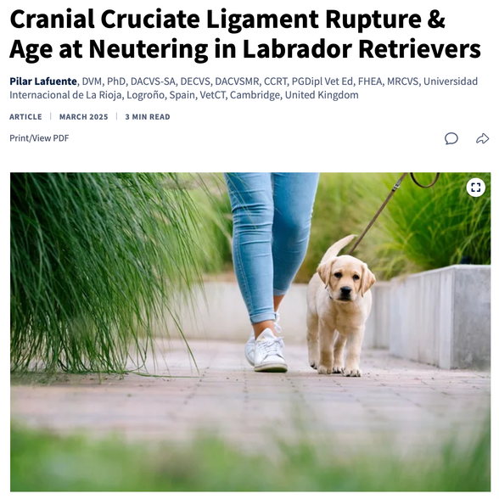
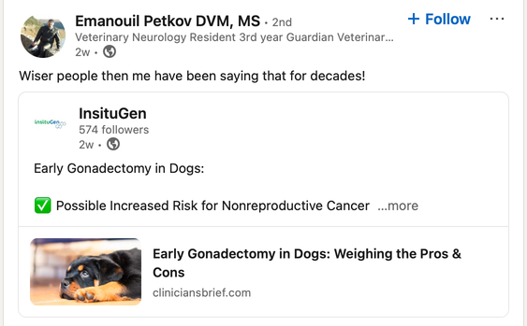
Results from NZ customers prove that
One size does not fit all...
380 tests sold since launch in NZ & UK!
...while scientific publishing continues to push the topic
9 month old male Jack Russell.
Suitable for surgical sterilisation according to UCD guidance.
NeuterReady result shows
still a puppy.
Too early for gonadectomy. Recommend to re-check after 3 months.
10 month old male German Shepherd.
Unsuitable for surgical sterilisation according to UCD guidance.
NeuterReady result shows
hormonally mature.
13 month old male Swiss Shepherd.
Unsuitable for surgical sterilisation according to UCD guidance.
NeuterReady result shows
still a puppy
Too early for gonadectomy. Recommend to re-check after 3 months.

Slide 18


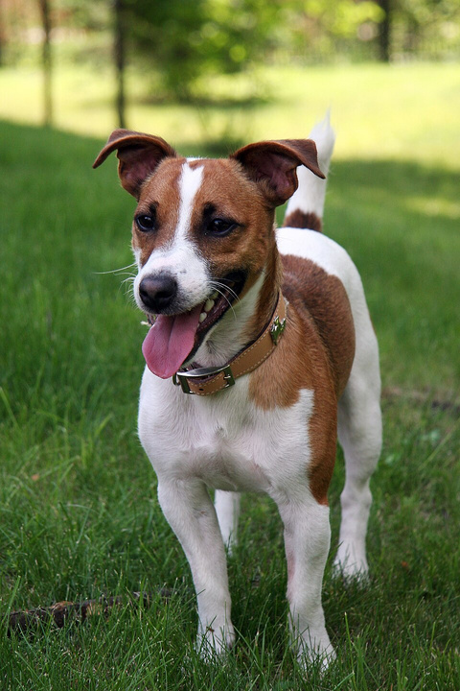
“
Knowing that time frame allowed us to make the best decision for our puppy and then to decide on chemical castration and review. We highly recommend taking this test that opens up real options based on new data
”
Owner of George, 9-month old Jack Russell

Slide 19








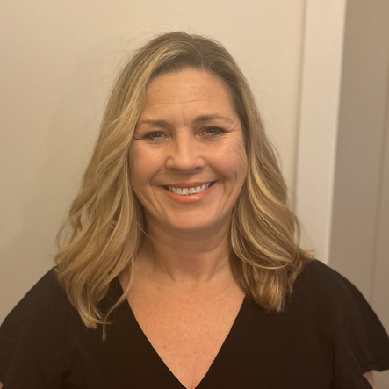

Meet the Team
Executive Team
Advisory
Thomas Bechter (CH)
CEO Director
A seasoned executive with over 25 years of experience in top management positions at large international corporations and family businesses.
Professor Alison Heather (UK)
CSO & Inventor
An academic professor with over 24 years’ of research on the physiology of steroid hormones and their role in health and disease, with international recognition for her development of bioassays for the detection of steroid hormones.
Dr Matthew Bull (NZ)
COO & CFO
An experienced analyst and academic research scientist with a background in translational drug development, commercialisation, and operations, and previous roles in investment and life sciences consulting.
Professor Dr Sandra Goericke-Pesch (GER)
University of Veterinary Medicine Hannover
Medical Advisor
A professor for Reproductive Medicine of Dogs and Cats, at the University of Veterinary Medicine Hannover, author of over 84 original research papers, reviews, and book chapters, German Diplomate for Animal Reproduction and Biotechnology of Reproduction, and treasurer and board member of the European Veterinary Society for Small Animal Reproduction (EVSSAR)
Dr Roland Toder (NZ)
Senior Advisor
A life sciences and international business development expert, with previous experience as a manager, board member and consultant to numerous successful companies in NZ and in Europe. Former member of insituGen’s board of directors
Board of Directors
Dr Oliver Gehrig (GER)
Chairman
A seasoned veterinarian with years of experience in sales and marketing within the animal health industry. Previous Head of Global Sales in the anti-doping division of Berlinger Special. Current CEO of Vet-X-Perts GmbH, a German health tech start-up.
Dr Gary Pace (USA)
Director & Co-founder
An experienced serial entrepreneur, director and senior operations manager of small to large-scale life sciences ventures in Australia, New Zealand and the USA. He has more than 40 years of experience in the development and commercialization of advanced technologies.
Andrea McKenzie (NZ)
Director
An experienced director and senior operations leader with a strong track record in organisational transformation, people leadership, and governance across corporate, charitable, and emerging venture environments.
Natalie Lloyd (NZ)
Director
Natalie Lloyd has extensive experience in the companion animal veterinary industry, having worked in a variety of roles since graduating from Massey University. Natalie currently works as a veterinary adviser for a multinational animal healthcare company and is also actively involved in both the global and local companion animal veterinary community.
Dirk Ehle (GER)
Director
Dirk Ehle is the former CEO of Bayer Animal Health and former President of Elanco Animal Health Europe. He brings significant expertise in global animal health markets, corporate strategy, and product development – as well as a strong industry network.

Slide 20

  insituGen is looking for strategic partners & investors to globally commercialize and to further expand insituGen’s unique “Hormone Health” technology platform.
  insituGen’s multi-patented technology platform delivers a differentiating competitive advantage with no direct competition addressing a multi-billion-dollar market.
  “Hormone Health” is the foundation for establishing routine hormone testing in pets.
  insituGen is raising a NZ$ 2m bridge round at a PMV of NZ$ 6m that delivers:
    4 markets live
      Ramp-up sales in NZ & UK. Enter AUS & GER. Prepare market entrance USA
    3 products launched
      Launch SpayReady & SpayCheck. Complete work on LongevityAnnual
    Point-of-Care ready assay
      Further simplification of our assay for PoC readiness
    Strategic partners signed
      For animal health and other application verticals

Slide 21
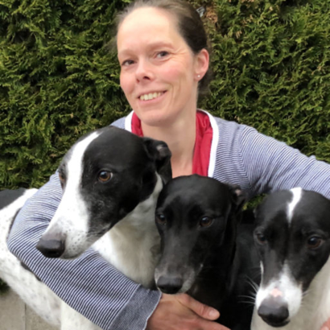
“
As a specialist in veterinary reproduction, I strongly support InsituGen’s NeuterReadyTM platform. For too long, per se neutering decisions have been made and especially also been overlooking hormonal maturity—a key factor in long-term health.
Detecting hormonal maturity before neutering allows for more personalized, informed decisions and reduces risks like behavioral problems or long-term health impacts, such as certain orthopedic problems. At the very least, it should be part of the conversation with the owner.
”
Prof. Dr. Sandra Goericke-Pesch
DECAR, University of Veterinary Medicine Hannover

Slide 22


Thank You!
www.neuterready.vet
www.neuterready.com
www.insitugen.com
info@insitugen.com
Copyright © 2026 - InsituGen. All Rights Reserved.

